Slide 1


Machine learning for physics and astronomy chapter 8
Viviana Acquaviva

Slide 2
(a very simple) INTRODUCTION TO NEURAL NETWORKS

Slide 3
Why Neural Networks?
Super flexible non-linear models for classification and regression
Work well for very large datasets
Non-convex optimization
Notoriously slow to train – need for GPUs
Use dot products, so require preprocessing → similar to SVM or linear models, unlike trees
MANY variants (Convolutional nets, Recurrent neural networks, autoencoders, generative adversarial networks...)
List adapted from https://amueller.github.io/COMS4995-s20/slides/aml-18-neural-networks/#9

Slide 4
Step 1: Linear Model
input (1 object)
1
output
x₁
features
x₂
x₃

Slide 5
Step 1: Linear Model
input (1 object)
1
output = w^{T} ∙ x
= w₀ + w₁x₁ + w₂ x₂ + w₃ x₃
w₀ (bias)
x₁
features
w₁
x₂
w₂
x₃
w₃

Slide 6
Step 2: Perceptron
input (1 object)
add non
linearity
1
w₀ (bias)
output = H(w^{T} ∙ x)
where H = Heaviside (step)
function
x₁
features
w₁
x₂
w₂
x₃
w₃
Simplest neural network!

Slide 7
Step 3: Stacking layers (MLP)
input (1 object)
z_{i} = H (w_{0,i} + w₁,_{i} x₁ + w_{2,i} x₂ + w_{3,i} x₃ )
w_{0,1}
1
w_{1,1}
z1
w_{0,2}
t₁
output
x₁
t₂
features
w_{2,1}
z2
y
w_{1,2}
x₂
w_{3,1}
t₀
w_{2,2}
y = H (h^{T} ∙ z)
= H(t₁z₁ + t₂z₂ + t₀ )
1
x₃
w_{3, 2}
hidden layer

Slide 8
Why non-linearity?
Let’s see what happens if we get rid of the non-linear activation:
input (1 object)
z_{i} = w_{0,i} + w₁,_{i} x₁ + w_{2,i} x₂ + w_{3,i} x₃
w_{0,1}
1
w_{1,1}
z₁
w_{0,2}
t₁
output
x₁
t₂
y = h^{T} ∙ z =
t₁z₁ + t₂z₂ + t₀ =
t₁ (w_{0,1} + w₁,₁ x₁ + w_{2,1} x₂ + w_{3,1} x₃ ) + t₂ (w_{0,2} + w₁,₂ x₁ + w_{2,2} x₂ + w_{3,2} x₃ ) + t₀
w_{2,1}
z₂
y
w_{1,2}
x₂
w_{3,1}
t₀
w_{2,2}
1
x₃
w_{3, 2}
hidden layer
Our network turns into a fancy linear function!

Slide 9
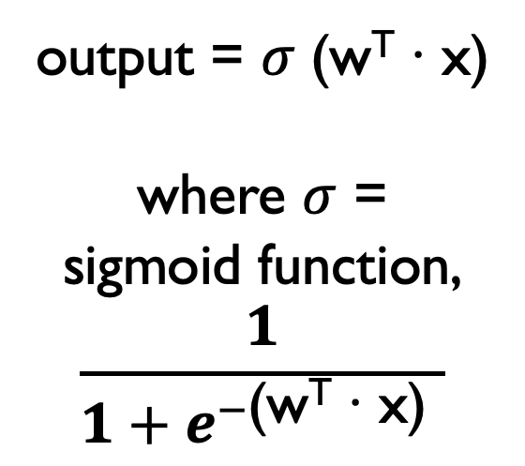
Step 4: A differentiable nonlinearity
input (1 object)
add non
linearity
1
w₀ (bias)
x₁
features
w₁
output = $σ$ (w^{T} ∙ x)
where $σ$ =
sigmoid function,
$$\frac{1}{1+e^{−\text{(}\text{wT}\text{ ∙ }\text{x}\text{) }}}$$
x₂
w₂
x₃
w₃

Slide 10
The XOR problem
Solve with linear model?
How about with linear model + non-linearity, like step function or sigmoid?
How many lines would you need?
Input
0, 0
0, 1
1, 0
1, 1
Output
0
1
1
0

Slide 11
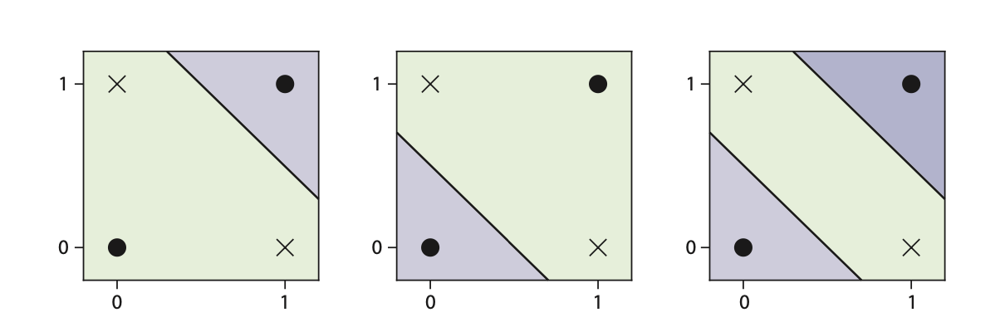
Multi Layer Perceptron and the XOR problem
The XOR can be
solved by two stacked
perceptrons (see diagrams), with Heaviside or logisitic
activation.
Note that there is no unique solution for the weights!
(it may be fun to guess them ☺ )

Slide 12
Mo layers, mo freedom
Hidden layers can be larger or
smaller than the previous layer
Each layer includes nonlinearity
@ output
The final layer has a different
activation:
For a class/probability: Heaviside,
logistic function, softmax
(if more than two classes)
For regression: e.g. linear model
Graphical proof that a NN can approximate any continuous function
(universality theorem)
http://neuralnetworksanddeeplearning.com/chap4.html

Slide 13
Training a neural network: inventory
So far I only know about architecture. What else do I need?
1. A loss function
2. A way of minimizing my loss function with respect to the parameters (weights, w)
(any suggestions?)
YES, GRADIENT DESCENT!
Problem: We know how to calculating the gradient dL/dw at one step, but:
- We can have many hidden layers, so we need to calculate gradients through all the layers.
- We can have many neurons/layers, we need to calculate gradients fast.

Slide 14
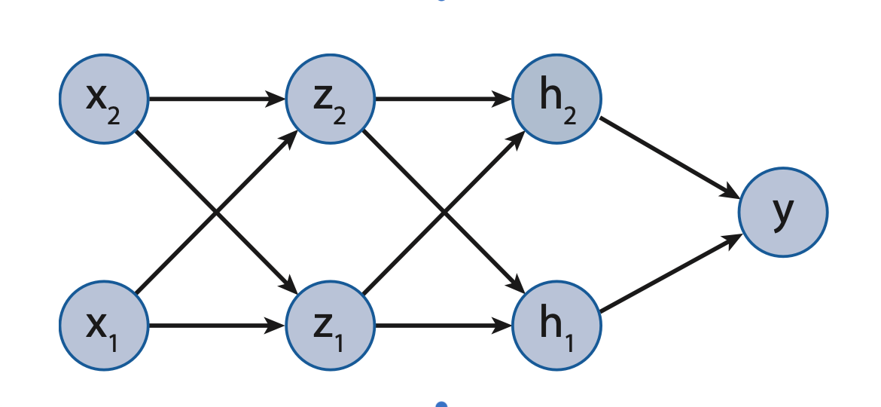
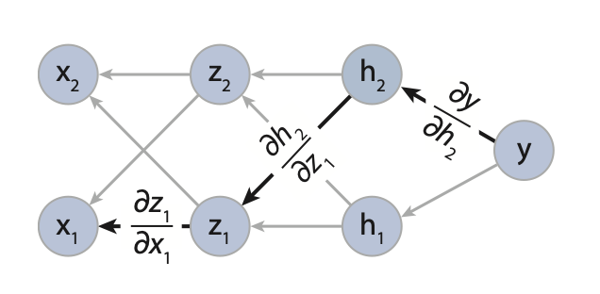
Calculating gradients
Calculating gradients is a very important component in training neural networks.
It helps to have a graphical representation of the connections, and to assign a partial derivative to each edge in the graph.

Slide 15
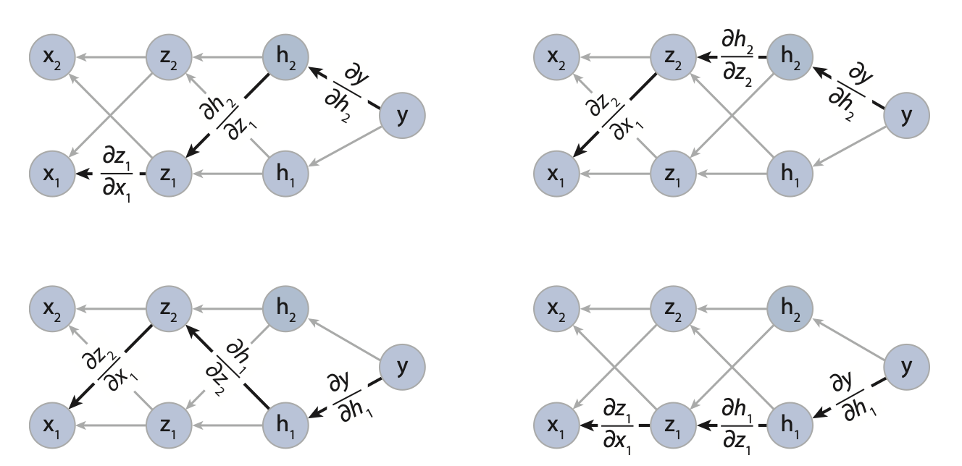
Calculating gradients
To calculate the gradient of one variable (e.g., y) with respect to another (e.g., x₁ ), we can simply find all the paths that lead from y to x and combine them by applying the chain rule.

Slide 16
How does the graph of derivativeS help?
How to calculate the derivative of node a w.r.t. node b:
Find an unvisited path from a to b
Multiply all edge values along this path
Add to the resulting derivative
Repeat until all paths have been taken

Slide 17
Training one layer using the chain rule
differential sigmoid
is better than H!

Slide 18
Pseudo-code for a fully connected Neural Network
Decide architecture (number, size, type of hidden layers, non-linearity, output layer).
Initialize weights (including biases).
For each training example, forward-feed through the network and compute loss (error). Sum up (on all the examples, or batch, or one for SGD).
Back-propagate the error by calculating the gradient of the loss with respect to all the weights using the chain rule. The smart version of this, which recycles already computed gradients, is called AutoDiff.
Take a gradient descent step from the current configuration of weights in the direction of the negative gradient, with step = learning rate.
Repeat for N epochs until convergence within given tolerance, or N_{max} is reached.

Slide 19
Playground.tensorflow.org

Slide 20
Improving on basic NNs
1. Architecture
2. Weight Initialization
3. Activation functions
4. Optimizers
5. Regularization

Slide 21
Wide and shallow, or narrow and deep?
1
1
x₁
x₁
y
y
x₂
x₂
x₃
x₃
Experts point to this as a more efficient structure
for same # of neurons (see discussion in
Chapter 10 of Geron’s book, Hands on Machine Learning with Scikit-learn, Keras, and TensorFlow ).

Slide 22
How do I pick the right size for each layer?
Cross validation, of course (it’s a parameter)!
It may be convenient to have a fixed # of neurons per layer, to keep the number of hyperparameters low
Common approach: “Stretch pants”: pick higher complexity than you need + regularization.
1
x₁
y
x₂
x₃

Slide 23
Initializing weights
Random? Always seems like a good idea!
Problem: Gradients are DISTRIBUTED along
a deep network.
1. The shape of the activation function can affect
them: Saturating ones → vanishing gradients
2. However, non-saturating functions can make
them explode! Activations that are symmetric
around zero are a bit better for this.
3. One can show what’s the right size,
but the initialization needs to be layer-dependent
Some popular activation functions

Slide 24
Initializing weights
Problem: Gradients are DISTRIBUTED along
a deep network.
Non-saturating activations are one good way to tackle this, but the problem of choosing the correct initialization for all layers remain.
Breakthrough:
Glorot (or Xavier) initialization
(Glorot and Bengio 2010):
Activation-tailored,
size-dependent initialization
(default in Keras).
Extended to ReLU by He et al (2015).

Slide 25
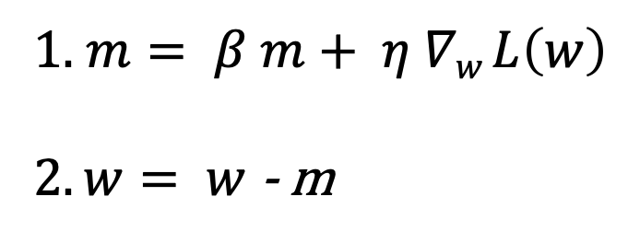
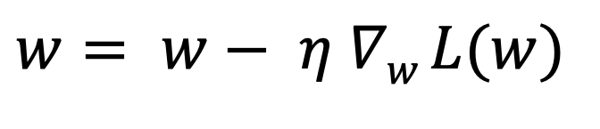
Optimizers
$$w= w− η ∇w L(w)$$
Gradient Descent: reliable but not optimal
Steps become small when gradient is small
Momentum trick: Gradient is used like a second-order
correction to current momentum (has hyperparam, β)
1. $m= β m+ η ∇w L\left(w\right)$
$2. w= w$ - m
AdaGrad / RMSprop: Adaptive learning rate + locally adjusted on last n iterations
Adam (ADAptive Momentum):
Very popular Momentum/RMSprop combo

Slide 26

Regularization
Early stopping:
Stop when validation (test) error starts increasing
L1, L2 regularization:
ok but add new weights/parameters
Popular: Dropout
(ignore a fixed fraction
of neurons in each training step)
Srivastava, Nitish, et al. ”Dropout: a simple way to prevent neural networks from overfitting”, JMLR 2014, reproduced with permission

Slide 27
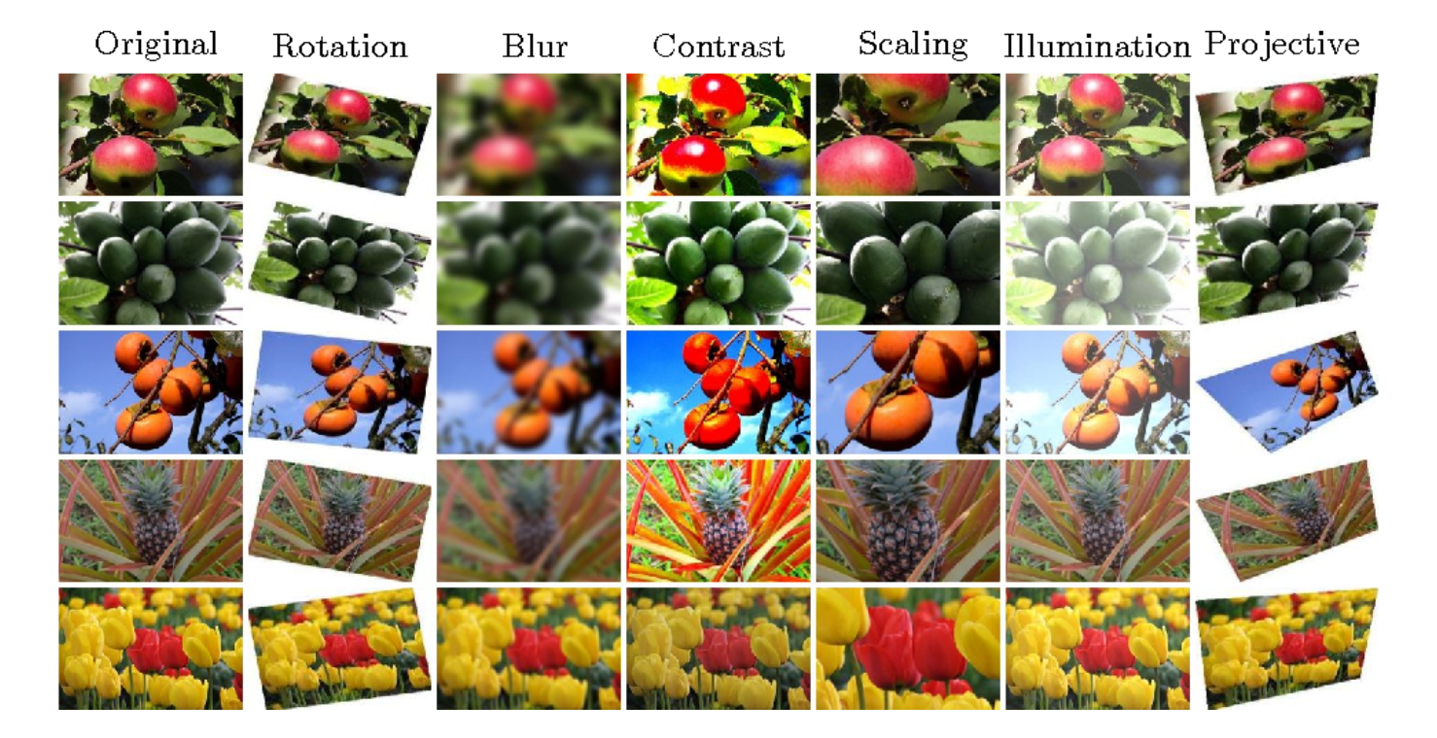
Data Augmentation
Image courtesy of Porrntiwa Pawara, from: https://link.springer.com/chapter/10.1007/978-3-319-70353-4_52

Slide 28
Beyond fully connected Neural Networks
Convolutional Neural Networks
Recurrent Neural Networks
Autoencoders
Generative Adversarial Networks

Slide 29
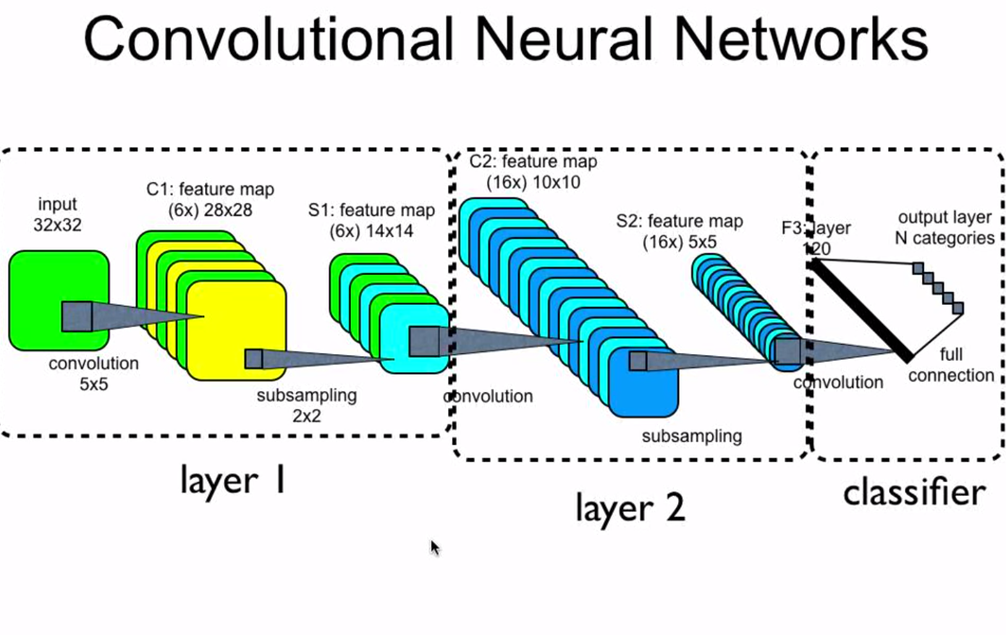
Convolutional Neural Networks
Figure from Acquaviva 2019, courtesy of Eugenio Colurciello
Built-in feature extraction mechanism
makes it perfect for image data (and more!)

Slide 30
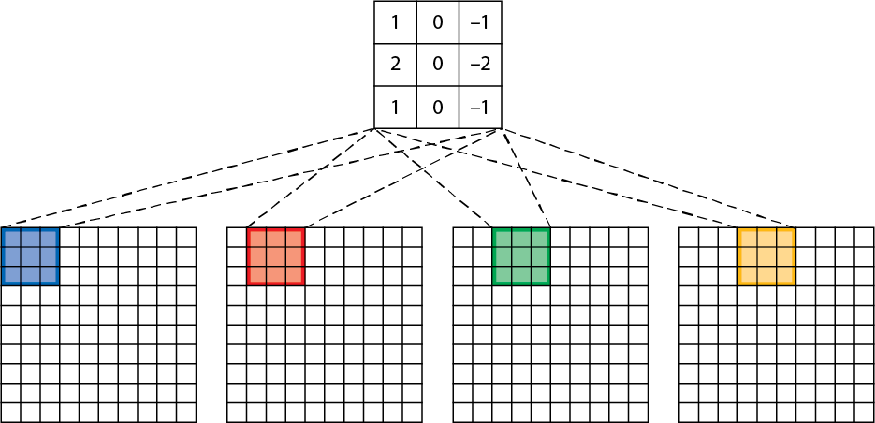
convolutional layers
Convolutional layers are typically used on images. They create additional feature maps by using filters. Filters are small matrices that reveal or enhance some features.
The small filter matrix multiplies element-by-element different regions of the image in a sliding window with a fixed step (stride).
Several filters are used to create multiple representations, so the input becomes 3D.

Slide 31
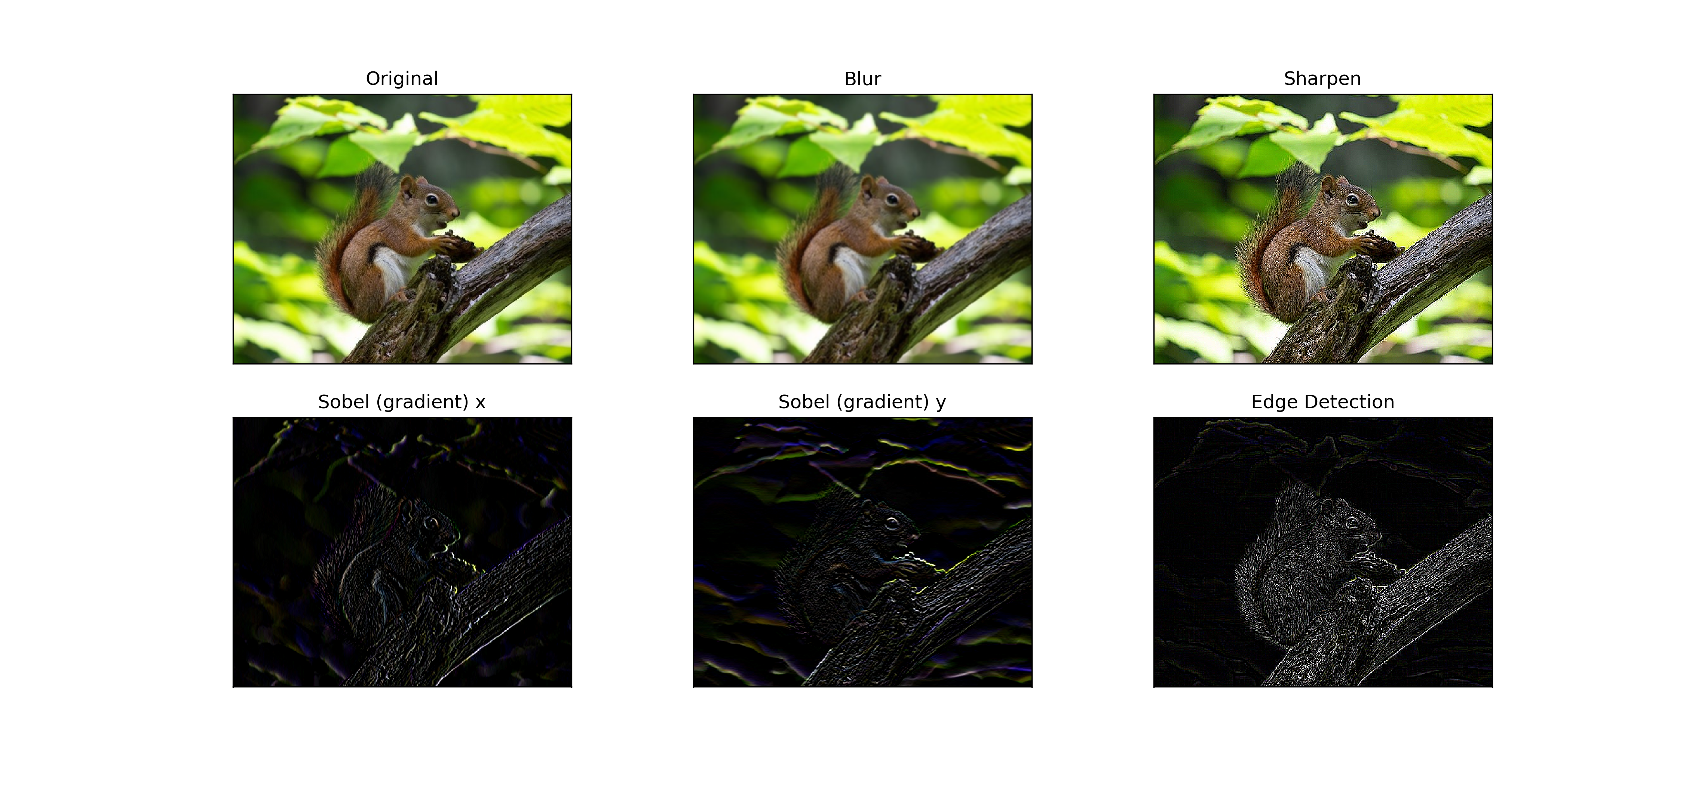
Effect of filters
1 | 1 | 1
1 | 1 | 1
1 | 1 | 1
0 | -1 | 0
-1 | 5 | -1
0 | -1 | 0
-1 | 0 | 1
-2 | 0 | 2
-1 | 0 | 1
1 | 2 | 1
0 | 0 | 0
-1 | -2 | -1
-1 | -1 | -1
-1 | 8 | -1
-1 | -1 | -1
This shows the effect of the convolution with various 3x3 filters (normalizations are omitted for simplicity). Note however that we don’t have to choose the filters in advance!
This is the super-power of CNNs: the filters are part of trained parameters.
We can also look at the feature generated at various convolutional layers and re-use them (transfer learning).
Original image source: OpenCV data samples
Notes:
Original image credit: OpenCV

Slide 32
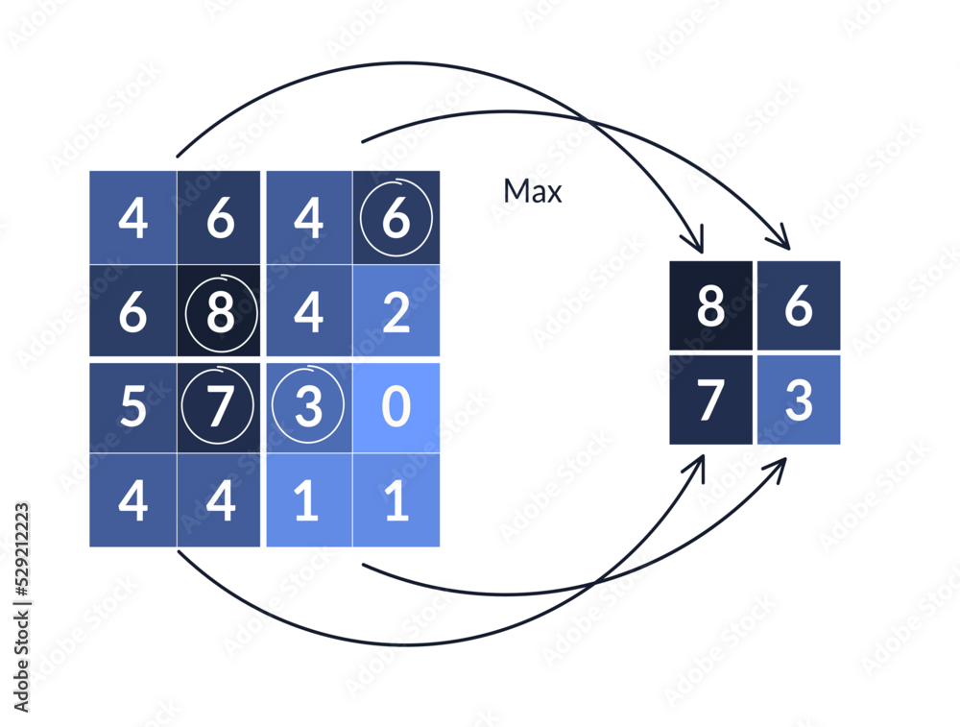
Pooling layers
Pooling layers are used to reduce the dimensionality of the network.
We literally take squares of adjacent pixels and replace them with one pixel that contains the average or, more commonly, the max value (max pooling) of the square.
Max Pooling
example
Notes:
This image is from Adobe Stock

Slide 33
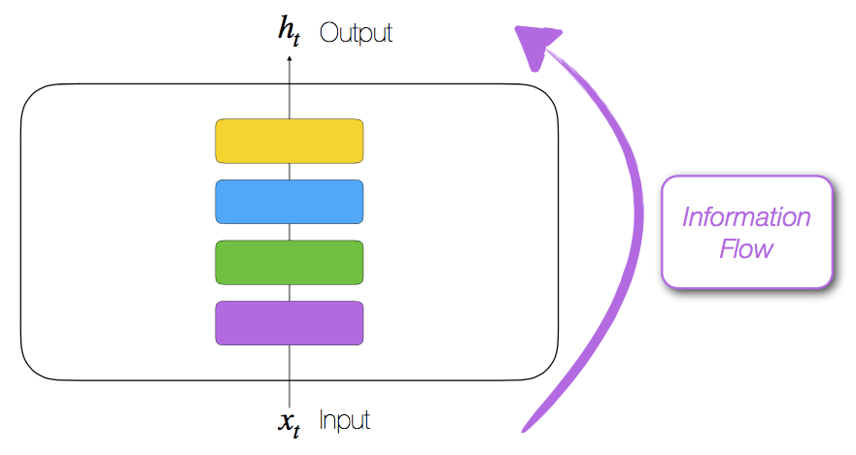
Recurrent Neural Networks
Forward-feed network
Recurrent neural network
Figures from Acquaviva 2019, courtesy of Bruno Gonçalves
Sequential:
The target prediction is based
on the input features and the outcome of the network at the previous step.

Slide 34
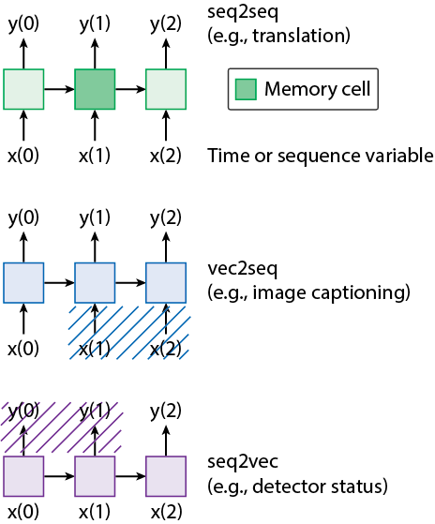
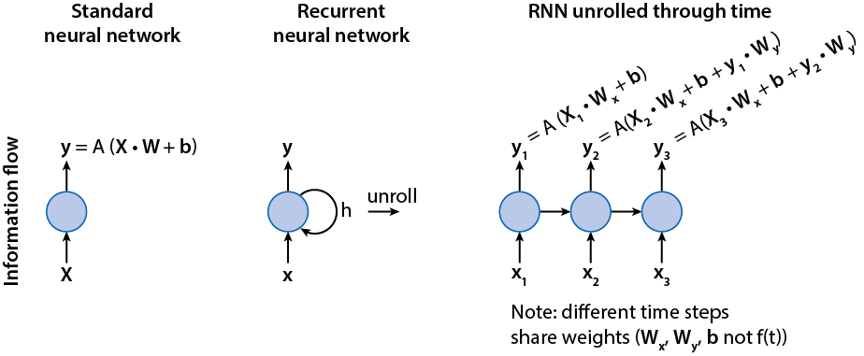
Recurrent Neural Networks

Slide 35
AutoEncoders
Unsupervised technique
The goal is to generate outputs that are as similar as possible to the inputs, but going through a lower-dimensional representation (middle layer: compressed latent representation)
The loss function is (some measure of) the difference between input and output
Figure reproduced with permission from Portillo et al 2020
Examples of applications:
Dimensionality reduction, denoising…

Slide 36
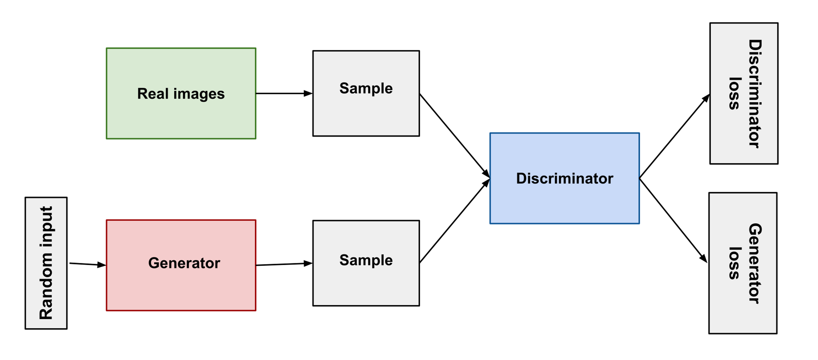
GENErative adversarial networks
Generative Adversarial Networks
Application example: Realistic simulations (also deepfakes)
Figure source: https://developers.google.com/machine-learning/gan/gan_structure

Slide 37
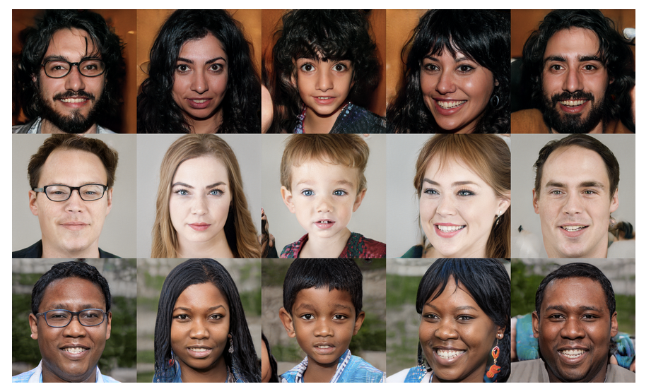
GENErative adversarial networks
https://github.com/NVlabs/stylegan
Data source: https://github.com/NVlabs/ffhq-dataset; details: https://arxiv.org/abs/1812.04948

Slide 38
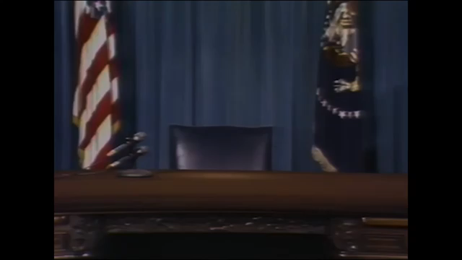
One more step
https://www.youtube.com/watch?time_continue=10&v=yaq4sWFvnAY&feature=emb_logo

Slide 39
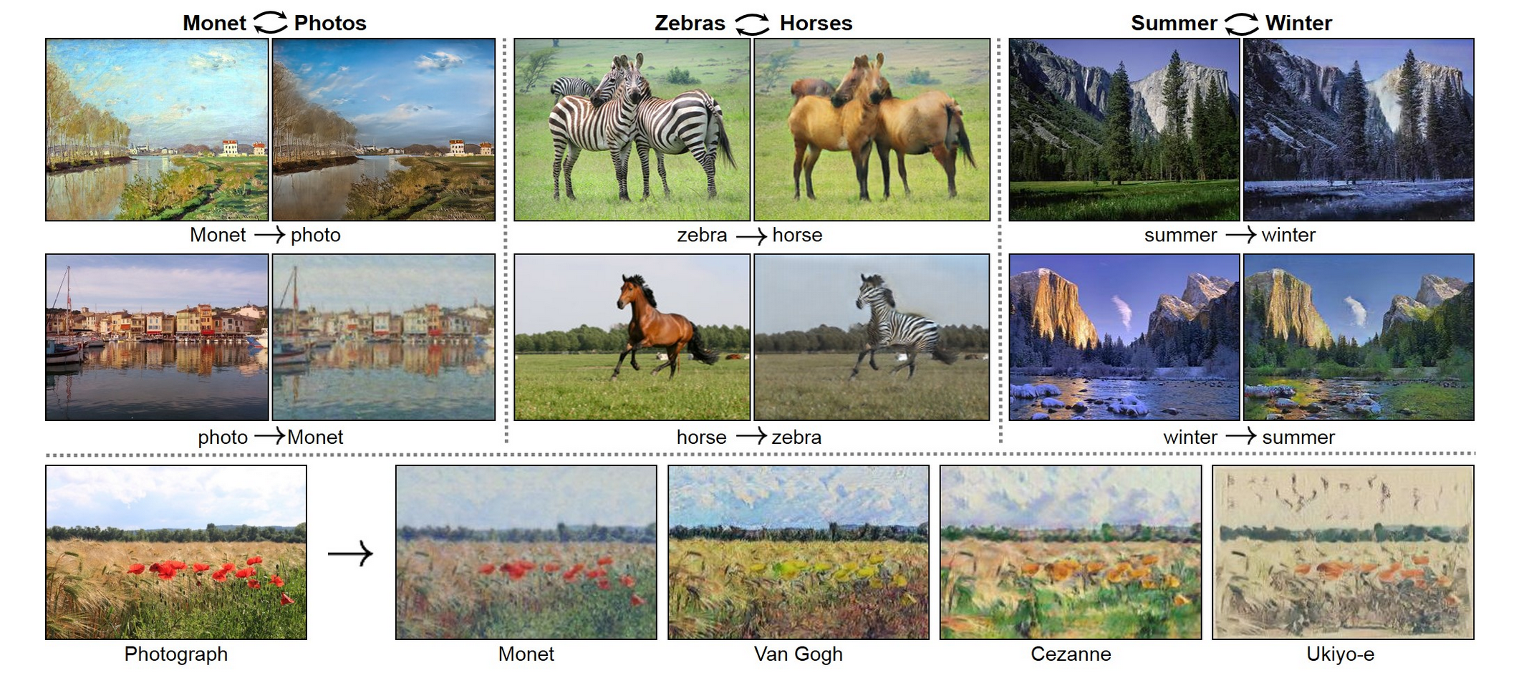
Something happier: cycle GANS
https://junyanz.github.io/CycleGAN/

Slide 40
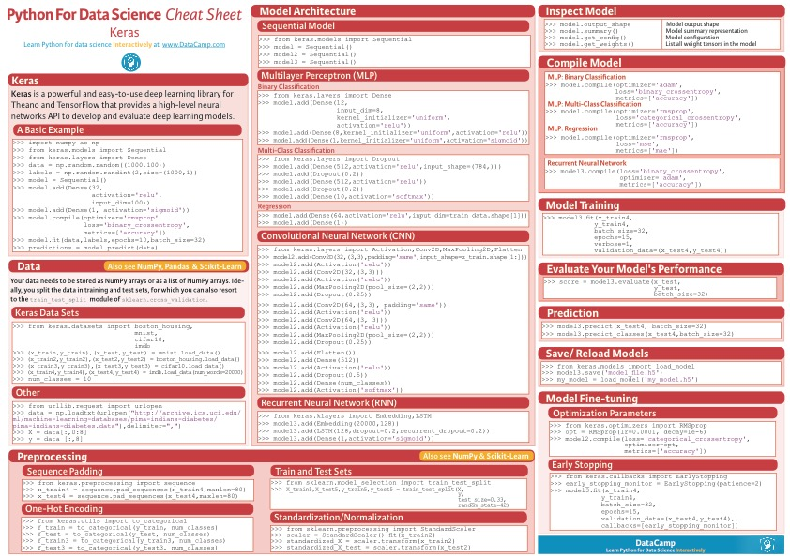
Simplest NN implementation: keras
Layers:
Dense
Dropout
Convolutional
Pooling
Flatten
LSTM
Cheat sheet from https://s3.amazonaws.com/assets.datacamp.com

